Slide 1


Lesson 1 – Repeated Themes & APL
ACCEPT, RESPECT, EMPATHISE

Slide 2
Repeated Themes
Year | Respect | Trust | Joy | Justice | Power | Choice
Y3 | I always ask before I touch someone else’s body. | I am learning to listen to my body. I know what information I can share with my friends. | I understand that everybody feels good sometimes and everybody feels bad sometimes. | I know that everybody needs help from others sometimes. | I am in control of my body. | I have a say in what happens to my body.
Y4 | I pay close attention to the words people use when they talk about themselves. | I trust myself to know what feels right for me. | I try to enjoy my body no matter what it is called. | I know that the person who knows most about who I am is me! | I know what I say and do can influence others. | I know I am allowed to change my mind.
Do these statements make sense to you?
How confident do you feel that you share these values?
Which ones could you try to be better at, especially in these lessons?
Why do you think this is important?
ACCEPT, RESPECT, EMPATHISE

Slide 3
APL - Body Parts
You are going to be shown images of private body parts.
One male and one female.
How many body parts can you name?
(Psssst...you learnt all of these in Y3!)
ACCEPT, RESPECT, EMPATHISE

Slide 4
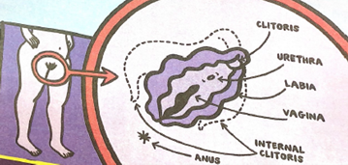
Female
ACCEPT, RESPECT, EMPATHISE

Slide 5
Female
Clitoris
This is both inside and outside the body. It is very sensitive. They are all different sizes. Most of the clitoris is inside the body.
Urethra
This is a small tube that urine comes out of.
Labia
Folds of skin around the opening of the vagina.
Vagina
Muscular reproductive organ.
Anus
This is the area where faeces is passed through and out of the body.
ACCEPT, RESPECT, EMPATHISE

Slide 6
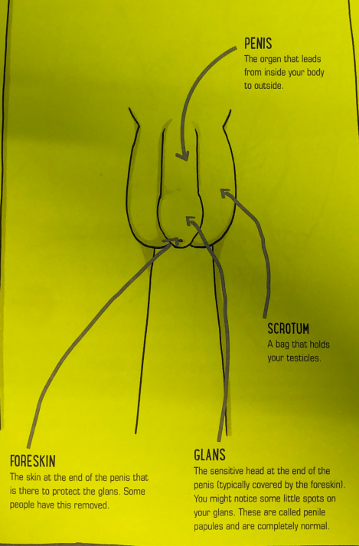
Male
ACCEPT, RESPECT, EMPATHISE

Slide 7
Penis
The organ that leads from inside your body to outside.
Scrotum
A bag that holds your testicles.
Glans
The sensitive end at the end of the penis typically covered by the foreskin. You might notice some little spots on your glans. These are called penile pepules and are completely normal.
Foreskin
The skin at the end of the penis that is there to protect the glans. Some people have this removed for medical or religious reasons.
ACCEPT, RESPECT, EMPATHISE

Slide 8

Next lesson...Puberty!
ACCEPT, RESPECT, EMPATHISE

Slide 9
Lesson 2 – Puberty
ACCEPT, RESPECT, EMPATHISE

Slide 10
Repeated Themes
POWER - I know that we all have power and can use it to change ourselves, to help others make changes in their lives and to make changes in the world.
TRUST - I know that it feels good to have relationships with people who deserve my trust.
Remember to start your sentences with, 'Someone I know...'
Please don't use names or identify people.
ACCEPT, RESPECT, EMPATHISE

Slide 11

Lesson 2 – Puberty
ACCEPT, RESPECT, EMPATHISE

Slide 12
Lesson 3 – Body Odour
ACCEPT, RESPECT, EMPATHISE

Slide 13
Repeated Themes
JOY- I know that respecting others in a relationship means letting them be who they are, not just who I want them to be.
CHOICE - I know that the choices I make say something about who I am. There is little justice or joy without choice.
Remember to start your sentences with, 'Someone I know...'
Please don't use names or identify people.
ACCEPT, RESPECT, EMPATHISE

Slide 14
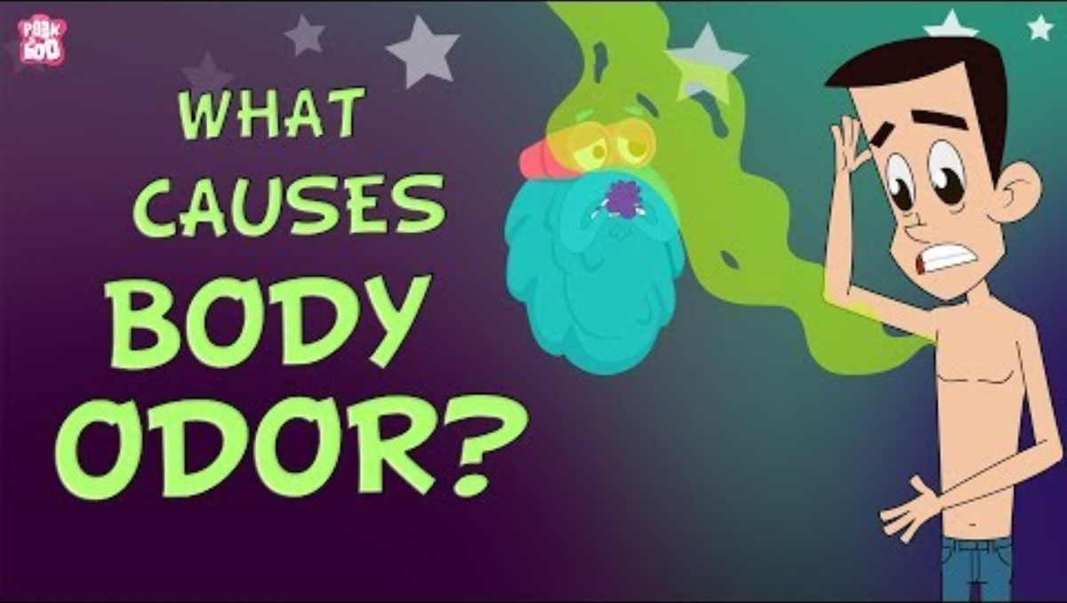
Remember to start your sentences with, 'Someone I know...'
Please don't use names or identify people.
ACCEPT, RESPECT, EMPATHISE

Slide 15
Experiment
Equipment: Warm water, salt, cotton wool, yeast
Dissolve the salt in the warm water – What does this represent?
Soak the cotton wool in the warm salt solution (This is now your sweaty skin)
Smell the cotton wool, note anything you can observe
Place the cotton wool in the yeast and leave for 10 minutes – What does the yeast represent? What do you predict will happen?
Remember to start your sentences with, 'Someone I know...'
Please don't use names or identify people.
ACCEPT, RESPECT, EMPATHISE

Slide 16
Lesson 4 – Periods
ACCEPT, RESPECT, EMPATHISE

Slide 17
Lesson 4 – Periods
Year | Respect | Trust | Joy | Justice | Power | Choice
Y5 | I understand that all kinds of relationships can bring me joy. | I know that it feels good to have relationships with people who deserve my trust. | I know that respecting others in a relationship means letting them be who they are, not just who I want them to be. | I understand that each of us gets to say who we are and choose who we want to be in a relationship with. | I know that we all have power and can use it to change ourselves, to help others make changes in their lives and to make changes in the world. | I know that the choices I make say something about who I am. There is little justice or joy without choice.
How are these themes relevant to learning about puberty and our changing bodies?
ACCEPT, RESPECT, EMPATHISE

Slide 18
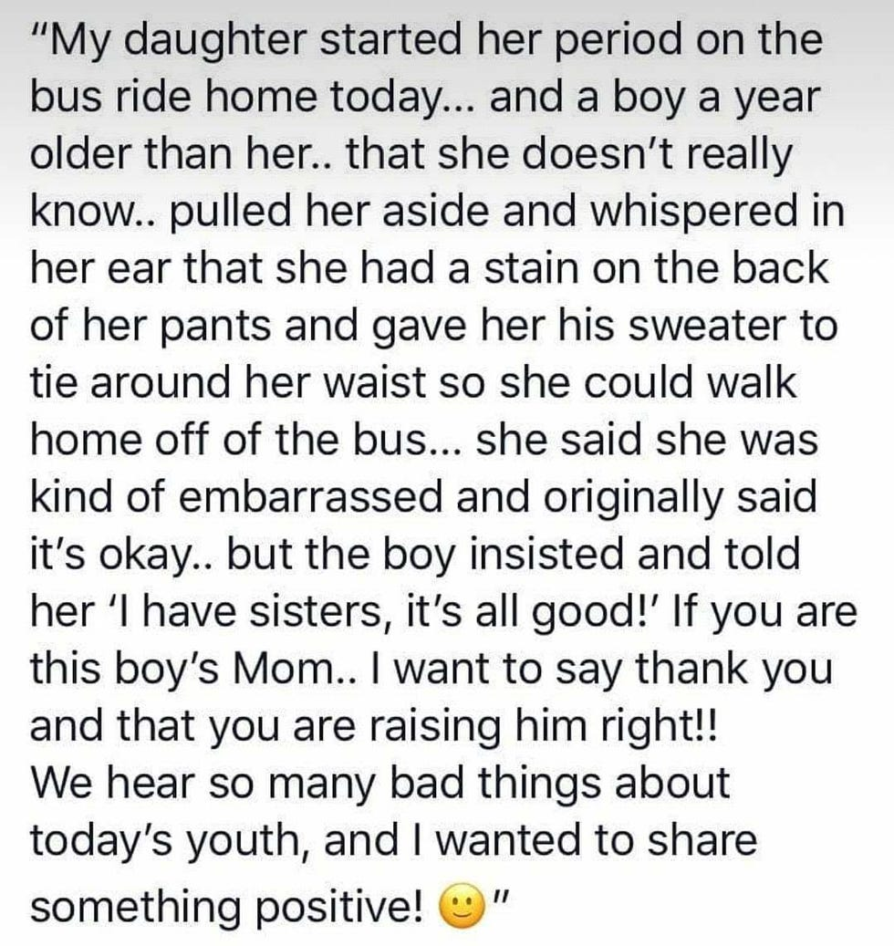
Lesson 4 – Periods
This is a true story from 2018
Why do you think it became such big news?
How do you think you would have reacted?
What do you think you would have done?
ACCEPT, RESPECT, EMPATHISE

Slide 19
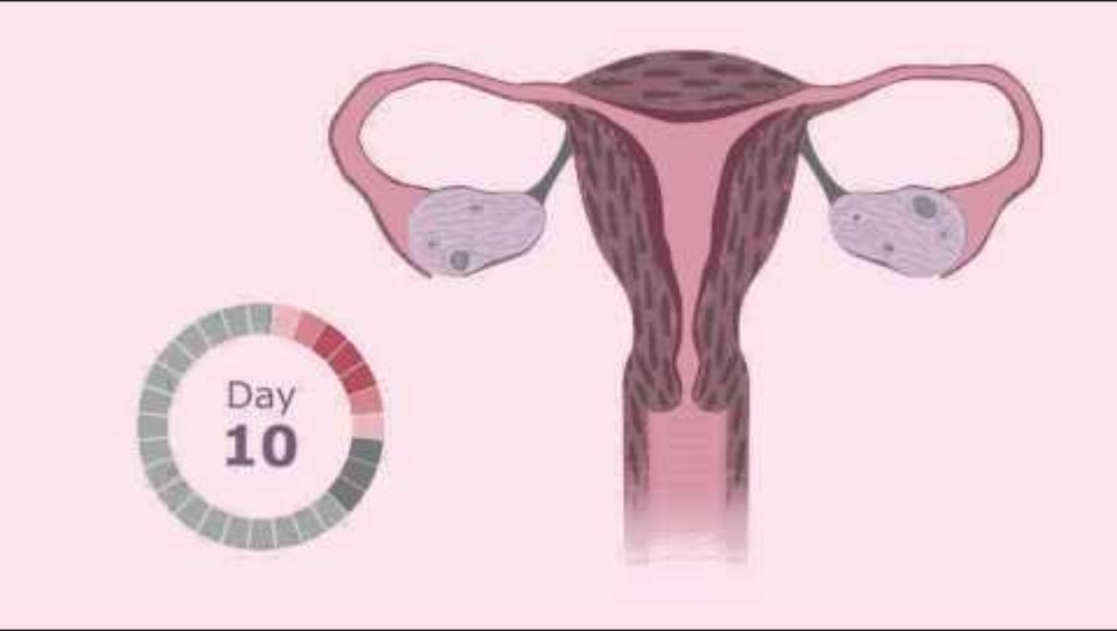
Lesson 4 – Periods
ACCEPT, RESPECT, EMPATHISE

Slide 20
TRUE OR FALSE: PERIOD PRODUCTS
A period is when someone pees blood.
FALSE:
Period blood does not come from the urethra, it is part of a separate
bodily system and comes from the womb, leaving the body through vagina.
Female bodies have three holes: urethra, vagina & anus
ACCEPT, RESPECT, EMPATHISE

Slide 21
TRUE OR FALSE: PERIOD PRODUCTS
A period is when someone loses a lot of blood each month.
FALSE:
The average blood loss is around 1-2 egg cups full but it can look like more.
If someone is losing a lot of blood they should see their doctor.
ACCEPT, RESPECT, EMPATHISE

Slide 22
TRUE OR FALSE: PERIOD PRODUCTS
A period is the name for shedding the lining of the womb.
TRUE:
If the egg is not fertilised then it dissolves and the lining of the womb breaks down ready to begin the cycle again.
ACCEPT, RESPECT, EMPATHISE

Slide 23
TRUE OR FALSE: PERIOD PRODUCTS
A period always comes every 28 days.
TRUE OR FALSE:
The average cycle is around 25-35 days –
it will be different for everyone
ACCEPT, RESPECT, EMPATHISE

Slide 24
TRUE OR FALSE: PERIOD PRODUCTS
The start of a period is Day 1 of the menstrual cycle.
TRUE:
There are four phases of the menstrual cycle:
Menstruation (period)
Follicular phase
Ovulation
Luteal phase
ACCEPT, RESPECT, EMPATHISE

Slide 25
TRUE OR FALSE: PERIOD PRODUCTS
A period is made up of blood alone.
FALSE:
Period blood is a mixture of tissue, blood & mucus
ACCEPT, RESPECT, EMPATHISE

Slide 26
TRUE OR FALSE: PERIOD PRODUCTS
A period always lasts for 5 days.
FALSE:
Period length varies from person to person, it normally lasts between 3-7 days
ACCEPT, RESPECT, EMPATHISE

Slide 27
TRUE OR FALSE: PERIOD PRODUCTS
You can hold in a period like you can hold in a wee.
FALSE:
The muscles in the vagina are not like the muscles in the urethra, you cannot stop or start period flow at will, it just drips out. This is why period products are used
ACCEPT, RESPECT, EMPATHISE

Slide 28
TRUE OR FALSE: PERIOD PRODUCTS
Period flow is always bright red
COULD BE TRUE OR FALSE:
Period flow can vary in colour from brown to bright or very dark red.
It may depend on the day of your cycle
ACCEPT, RESPECT, EMPATHISE

Slide 29
TRUE OR FALSE: PERIOD PRODUCTS
Most people with a female body have periods between the ages of around 12-55.
TRUE:
There is variation in ages but most biological females will have regular periods between menarche (first period) and menopause (end of periods)
ACCEPT, RESPECT, EMPATHISE

Slide 30
TRUE OR FALSE: PERIOD PRODUCTS
Periods are natural and a normal part of growing up for anyone with a female body.
TRUE:
All women will have slightly different experiences of periods but it is important for them to understand what is normal for them.
If your period stops then it is either because the egg has been fertilised and you are having a baby.
Or it could be a sign that your body is unwell or not getting everything it needs.
ACCEPT, RESPECT, EMPATHISE

Slide 31
TRUE OR FALSE: PERIOD PRODUCTS
All period products are thrown away after use
FALSE:
Some period products are disposable (used once and thrown away)
Some are reusable (used, washed and used again many times)
ACCEPT, RESPECT, EMPATHISE

Slide 32
Lesson 5 – Puberty...again!
ACCEPT, RESPECT, EMPATHISE

Slide 33
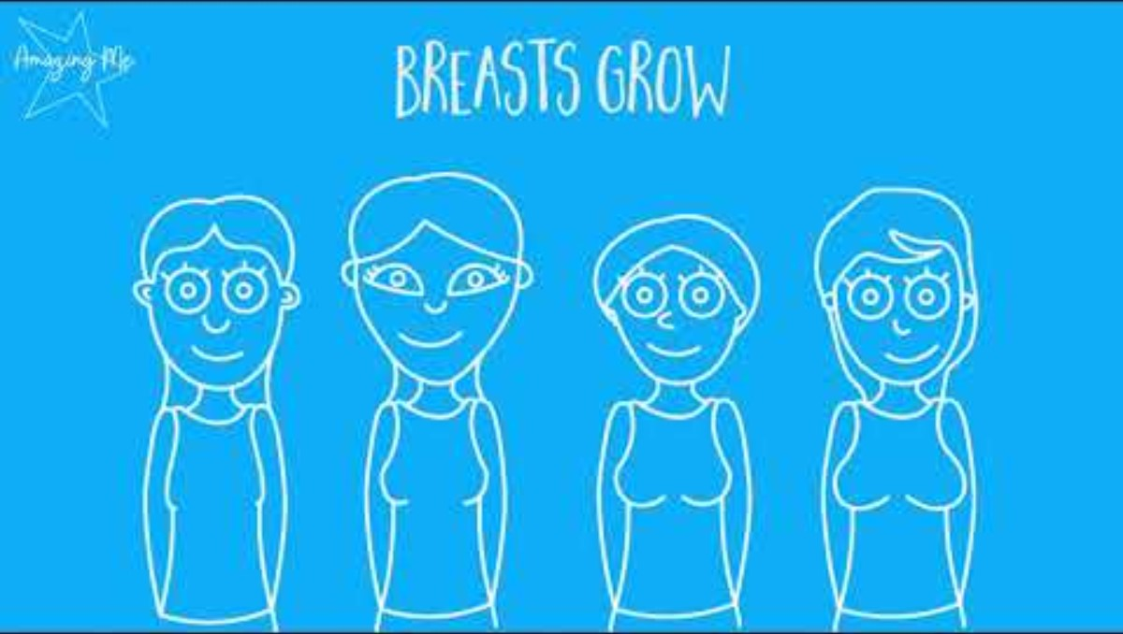
Puberty
ACCEPT, RESPECT, EMPATHISE

Slide 34
Lesson 5 – Puberty...again!
Last chance for any questions you may have!
We can't promise to answer all of them but we will do our best
Remember, your body is unique and your experience of puberty might be very different to your friends
Try to learn and be comfortable with what is normal for you
If something feels different then don't be afraid to talk to an adult you trust
No-one should be touching you in private places unless it is for medical reasons and they are a medical professional. If this needs to happen,
as child you will always have a trusted adult present
Remember consent and body autonomy
ACCEPT, RESPECT, EMPATHISE

