Slide 1
Aims for session
To be transparent and build trust so we can work together to teach our children
Explain rationale behind new curriculum
Share learning objectives, topics and vocabulary covered
Answer any questions you have regarding coverage
Please, if at any point you need to take a break or feel uncomfortable talking about any of the subjects we are covering then pop out for as long as you need to.
Notes:
Everyone has the right to pass. Explain that this is also how we introduce more sensitive subjects to children and there is never any requirement for them to comment if they don't wish to. We will always provide signposting to support like ChildLine when we cover potentially triggering topics.

Slide 2
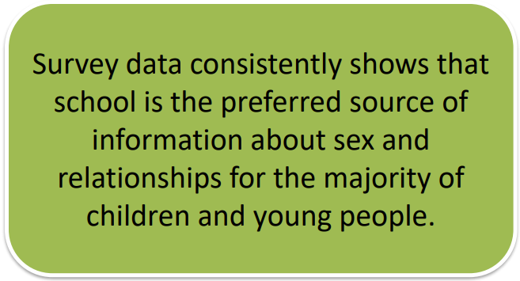
Quick Quiz
The majority of children and young people want to learn about sex from school.
True or False?
TRUE
Notes:
The majority of parents are also happy that their children have been able to have these conversations with peers but guided by a trusted adult.

Slide 3
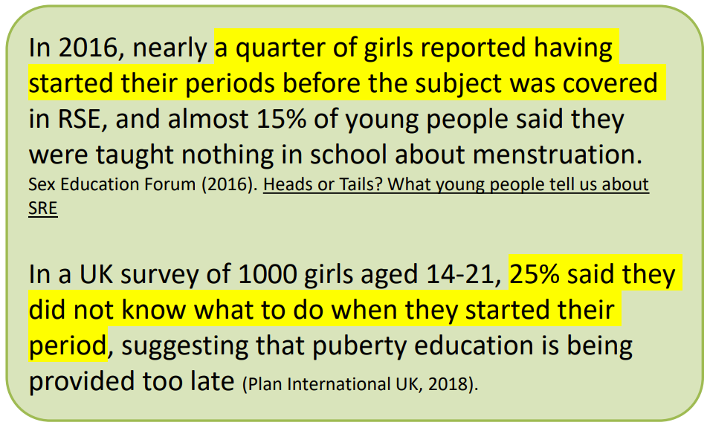
Quick Quiz
What proportion of girls had started their periods before they had learnt about them in school?
1 in 4
1 in 10
1 in in 20
a) 1 in 4!
Notes:
Although the average age of starting periods has not changed dramatically over the last 20 years, girls are developing breast buds around the age of 8 or 9 which means they are presenting as physically older. The same can be said for penile and testicular growth. Mood swings are also appearing earlier and research is showing that this is often the first sign of pre-puberty kicking in. Simply put, these tween behaviours and changes are going to be affecting the children in junior school most likely from year 4.

Slide 4
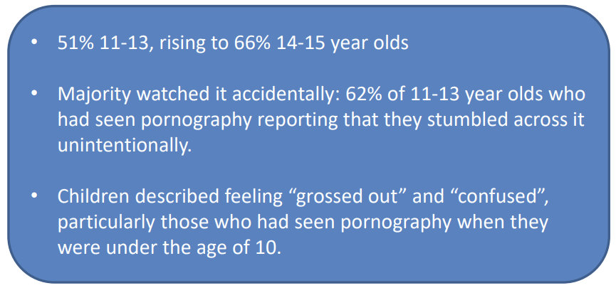
Quick Quiz
What percentage of 11–12-year-olds reported having seen pornography?
51%
Notes:
Regardless of the parental controls we put on our children's devices it can still happen. A friend showing them something on their phone – peer pressure to feel like they have to engage with something they don't feel comfortable with. Accidentally searching for something and clicking on the wrong link. We need to ensure our children understand what pornography is and most importantly who it is made for to help them make sense of what they are seeing. Porn addiction is a problem for teenage brains and can rewire their dopamine receptors causing them to seek out more and more damaging images.

Slide 5
Quick Quiz
Why is it important to use the correct terms for genitalia?
Because Ofsted inspectors will be looking for evidence
Safeguarding
Personal care and hygiene
Core skills for RSE
To reduce stigma and embarrassment
ALL OF THEM!
Notes:
This curriculum is about the safety and empowerment of our children. We want them to make healthy, informed and safe decisions as they get older. We always ensure our decisions are compliant with Ofsted requirements but this is not the priority when it comes to planning our curriculum. Our aim is to be engaged with our community and support our children to grow and learn.

Slide 6
Statutory Guidance
SCIENCE: Y5 Statutory requirements:
Pupils should be taught to:
describe the differences in the life cycles of a mammal, an amphibian, an insect and a bird
describe the life process of reproduction in some plants and animals.
Non – statutory guidance:
Pupils should find out about different types of reproduction, including sexual and asexual reproduction in plants, and sexual reproduction in animals.
Pupils should draw a timeline to indicate stages in the growth and development of humans. They should learn about the changes experienced in puberty.
https://assets.publishing.service.gov.uk/media/5a806ebd40f0b62305b8b1fa/PRIMARY_national_curriculum_-_Science.pdf
RSE:
It will be for primary schools to determine whether they need to cover any additional content on sex education to meet the needs of their pupils. Many primary schools already choose to teach some aspects of sex education and will continue to do so, although it is not a requirement.
https://assets.publishing.service.gov.uk/government/uploads/system/uploads/attachment_data/file/1090195/Relationships_Education_RSE_and_Health_Education.pdf
Notes:
DfE guidance is constantly evolving. The review promised in 2023 still has not been published. As a school we want to plan something that we are confident meets the needs of the children and fits in with our whole school culture and values. We are confident that this curriculum is the best fit for our school and will remain compliant with any changes in government advice. We have a statutory requirement to teach children about the changes in their body as they age which includes puberty. We try to approach this in a holistic way and support this information with an understanding not only of what but why and how.

Slide 7
Statutory Guidance
Is it mandatory to teach RSHE?
Yes, it is mandatory for RSHE to be taught in all schools.
We expect all schools to teach the full RSHE curriculum to secondary age pupils and relationships and health education to primary age pupils.
Primary schools may also teach sex education where appropriate. The teaching of RSHE is reviewed by Ofsted at inspection.
All schools must have in place a written policy for Relationships Education and RSE and consult parents in developing and reviewing their policy.
Schools should also ensure that the policy meets the needs of pupils and parents and reflects the community they serve.
Parents with concerns should speak to their headteachers and schools should listen to these views. However, parental consultation does not amount to a veto on curriculum content.
Parents will have a right to request that their child is withdrawn from sex education, but not from Relationships Education.
https://educationhub.blog.gov.uk/2023/03/10/what-do-children-and-young-people-learn-in-relationship-sex-and-health-education/

Slide 8
Training and research
Courses:
Sex Education Forum
Teaching Sex Education and Puberty in Primary School 04.04.23
Sex Education and Rethinking Our Response – 08.11.23
Annual Member's Event with guest speaker Dr Polly Haste (Ofsted) 29.11.23
Surrey CC
PSHE Leaders and Champions (Funded by the Home Office as part of a project to reduce violence against women) - 23.03.23, 05.05.23, 23.06.23
Reading:
This is so Awkward, Cara Natterson, MD & Vanessa Kroll Bennett
Sex Ed: An Inclusive Teenage Guide to SEX and Relationships, School of Sexuality Education
The Female Body Bible, Dr Emma Ross, Baz Moffat & Dr Bella Smith
Notes:
The courses were attended by Lorna Moore (PD lead) who has used this information to inform the creation of the curriculum alongside government guidance. The additional reading was for further research and more specific recommendations by experts. This is so Awkward is a good parent guide to the changes their child is going to be facing as they approach puberty.

Slide 9
Policy
Rationale
At Meath Green Junior School we believe that an open and honest sex education curriculum provides children with the tools to prepare them for a safe and healthy future. We have worked hard to ensure that children learn at an age and stage appropriate level which reflects their physical and mental health needs. The curriculum has been thoroughly researched and decisions have been made based on up-to-date data on child development and puberty. It is our aim to ensure that all children feel comfortable with their bodies and have an understanding of how they will change as they grow and mature. We have also included the repeated themes of respect, trust, joy, justice, power and choice which provide the spiral curriculum upon which learning is based. Our Sex Education lessons are delivered as part of our Personal Development curriculum and great care has been taken to link our resources with those used in the No Outsiders scheme. In line with our ARE approach in Personal Development, the children are taught to Accept, Respect and Empathise with physical and emotional differences in others. Our use of the Massage in Schools Programme (MISP) introduces and reinforces the concept of consent in children so they can develop body autonomy. Guidance from the DFE, PSHE Association and the Sex Education Forum has been followed.

Slide 10
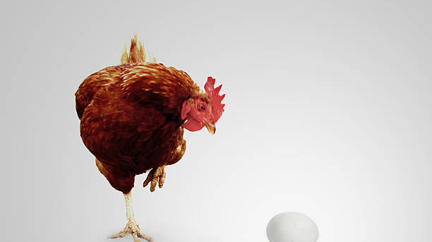
Why?
We need to prepare children for the changes they are about to experience in their bodies. It is difficult to do this without giving them some information about reproduction
Our job is not to teach them specifically about sex but puberty. 'Puberty is the path to reproductive capability NOT sexual maturation.' (This is so Awkward)
Questions about sex will arise but will be dealt with in an age and stage appropriate way
As a school we have agreed that our definition of sex is:
'Intimate touch between private parts'
Our curriculum is designed to be informative and not instructional
We want children to be comfortable with the changes they are about to experience but understand them in a way that is relevant, interesting and fun
Evidence shows that where children know the anatomically correct names makes it easier to report abuse. Through MISP we empower our children to understand consent which is another layer of protection.
Notes:
The title Sex Education causes too much confusion with parents. We aren’t really teaching them about sex at all but about the way their bodies are going to change in preparation for making a baby, if they choose to, when they are adults which is in line with the statutory requirements for science. We will have fun in the lessons. It is important to laugh and have fun with this topic within our ARE (accept, respect & empathise) values. We already very successfully teach the children about the concept of consent through our MISP routine.
Kenny and Wurtele (2008) found that the use of anatomically correct language equips children with the necessary language required to expose abusers, with children found to be more likely to report abuse they are experiencing if they know anatomically correct names (Wurtele & Kenny, 2010). Elliot et al. https://www.tandfonline.com/doi/full/10.1080/10538712.2021.1985672#:~:text=Kenny%20and%20Wurtele%20(2008)%20found,Elliot%20et%20al.

Slide 11

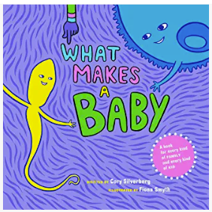



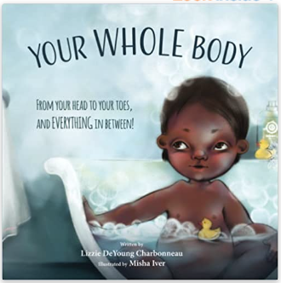
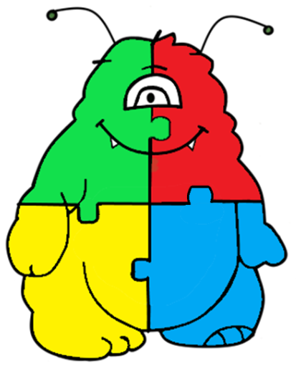

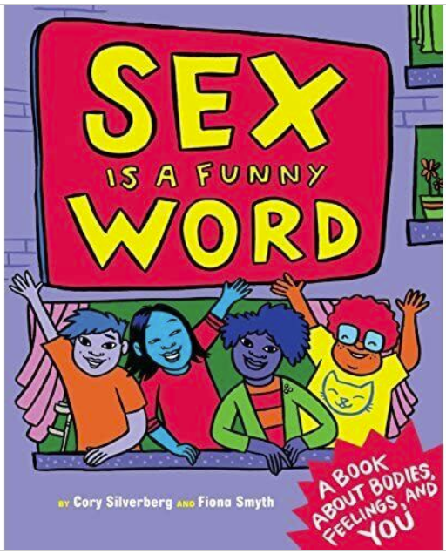
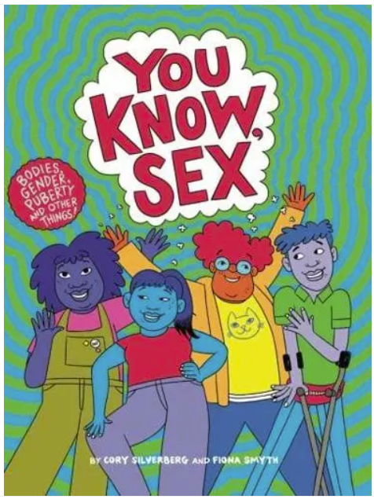

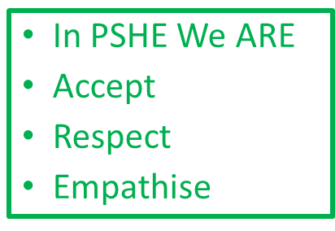
Resources
Notes:
As a school we decided to make the move away from using Jigsaw. It was costly and more importantly not meeting the needs of the children. Pupil and staff voice revealed that the materials were boring and repetitive. Different schemes were researched but we felt it should be something more in keeping with the rest of our curriculum. We will NOT be using all of these books in their entirety. The exceptions being Your Whole Body in Y3 and What Makes a Baby in Y4. The other books have carefully selected images, chapters or sections to be used as a starting point for conversations. If parents want to buy them to read at home with their children then we recommend they read them first as there may be some sections that you don’t feel are suitable yet. The children will only have access to the sections selected for the curriculum which will be shared with parents well in advance of lessons being delivered.

Slide 12
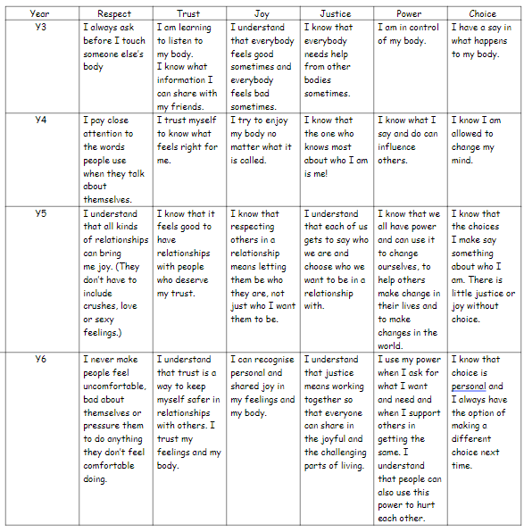

Repeated Themes
Respect, trust, joy, justice, power, choice
Spiral curriculum
Links with new PD curriculum
Great texts
Inclusive and empowering
SAFEGUARDING
Notes:
These repeated themes are taken from the Corey Silverman books and form the thread of his two more detailed books: Sex is a Funny Word and You Know Sex. These repeated themes link with our school & PD values and are therefore reflected across the curriculum and the behaviour policy. They are carefully pitched so we are laying the groundwork for their future relationships within an age appropriate context using carefully selected resources.

Slide 13
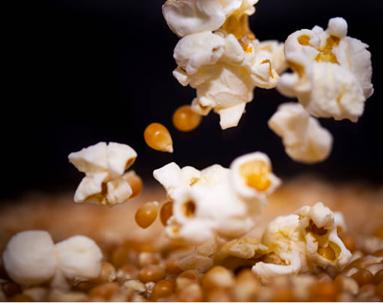
When and How?
The normal range for the onset of puberty is between 8 and 14
To promote good mental health children need to be prepared for these changes. They must also be confident that each individual is unique and they won't all have the same experiences at the same time
It is important to teach boys and girls together so they can be sympathetic to the changes others will experience. We aim to demystify and promote acceptance and empathy for our differences.
Notes:
The popcorn analogy is that all kernels pop at a different rate, just like children entering puberty. Evidence proves that late bloomers will not necessarily turn out to be less developed. We want all the children to feel 'normal' and understand their own bodies and feelings as they go through puberty. We are 'future proofing' their development.

Slide 14
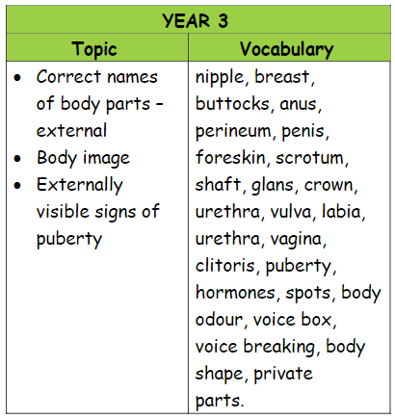
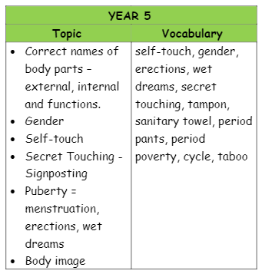
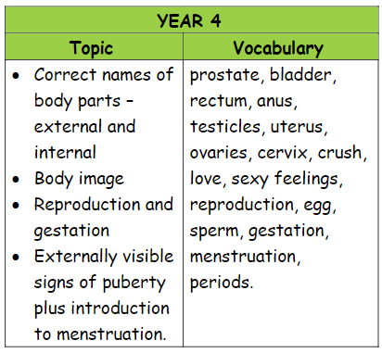
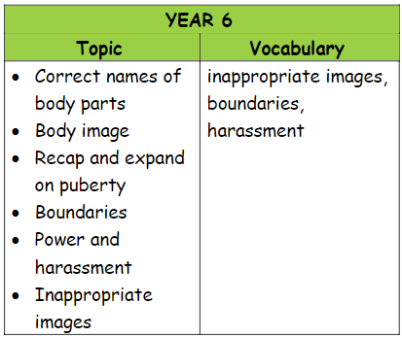
What?
Notes:
The list of vocabulary in year 3 comes from Your Whole Body which is a beautifully inclusive and informative book. Although as adults we might find some of the words more uncomfortable to use it is important for our children's health and wellbeing that they can use the correct vocabulary for their bodies. We have a legal requirement to be inclusive and represent diversity but we do this under our school and PD values and culture by using representation in the books and images we use in lessons. The curriculum is coherent and cohesive and builds on children's knowledge each year. Evidence of learning will continue to be collated in their class scrap books as part of their PD lessons and can be returned to and built on. When children are old enough to access adult images they need to understand what they are seeing and be able to navigate the digital world, knowing what is safe behaviour both off and online. An understanding of AI and how illegal images can be easily created. Children need to have an understanding of the law and consequences for their actions as they can be treated not only as victims but also perpetrators. Cases of misogyny are rising and we need to address these whilst children are young enough to break the cycle.

Slide 15
Next steps...
Meet with teachers from year groups to plan lessons
Publish resources and overviews on new website
Email parents in advance of lessons to highlight upcoming coverage
Continue to work with parents and wider school community to ensure needs of the children are being met
Remain informed on Government guidance and Surrey recommendations
Ensure staff are kept up to date with new training

Slide 16
Please remember
We are still in the planning phase of the curriculum and the consultation on Wednesday 6th December will inform our lesson plans. It was an invaluable opportunity to listen to feedback and make any necessary adjustments to suit the needs of the community. As soon as we have the final scheme planned we will share resources with parents and then inform you of how to request to withdraw your child should you still wish to do so. I estimate this being around February 2024 with the children receiving the lessons in March 2024. If you have any further questions or comments please contact the Personal Development lead l.moore@mgjs.org and we will endeavour to reply as soon as we can.

