Slide 1
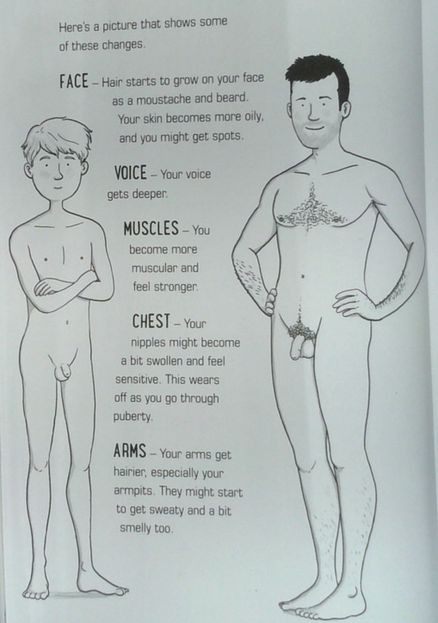
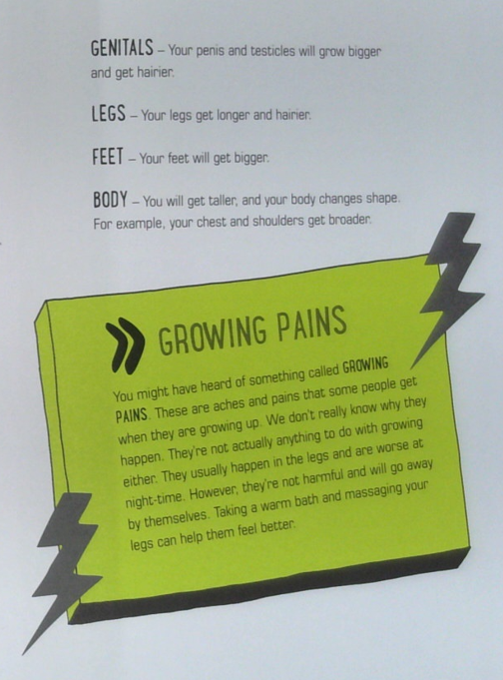


Year 3 Resources
ACCEPT, RESPECT, EMPATHISE

Slide 2
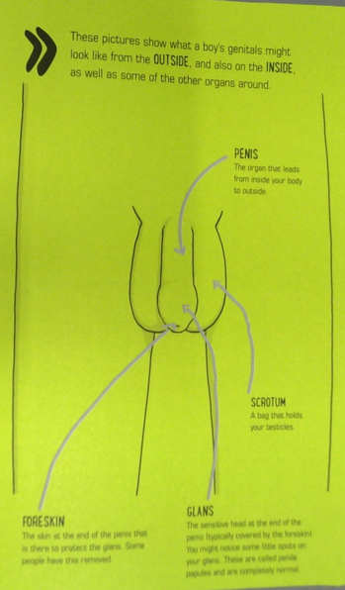
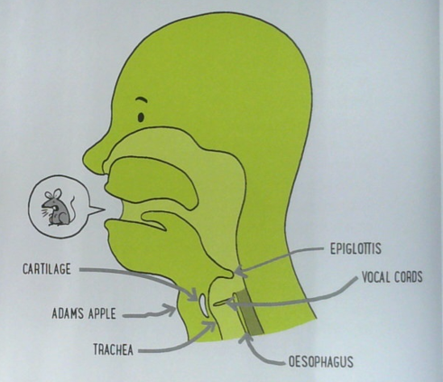
Year 3 Resources
ACCEPT, RESPECT, EMPATHISE

Slide 3
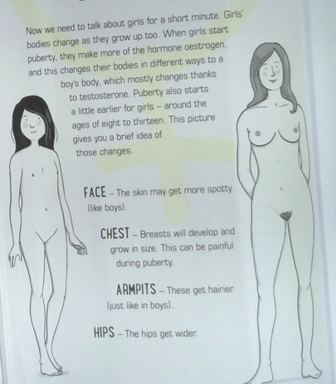
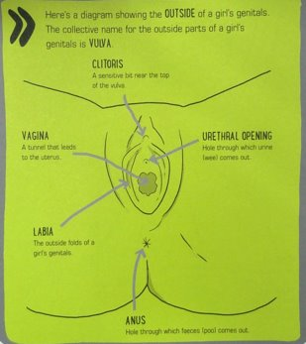
Year 3 Resources
ACCEPT, RESPECT, EMPATHISE

Slide 4

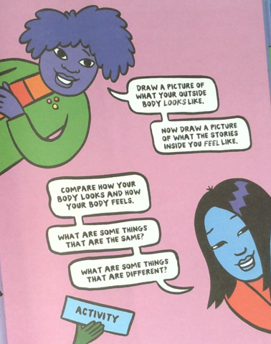
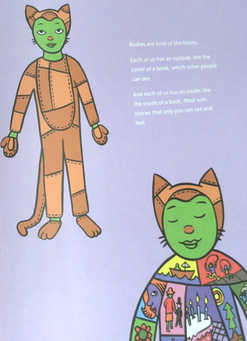

Year 3 Resources
ACCEPT, RESPECT, EMPATHISE

