Slide 1
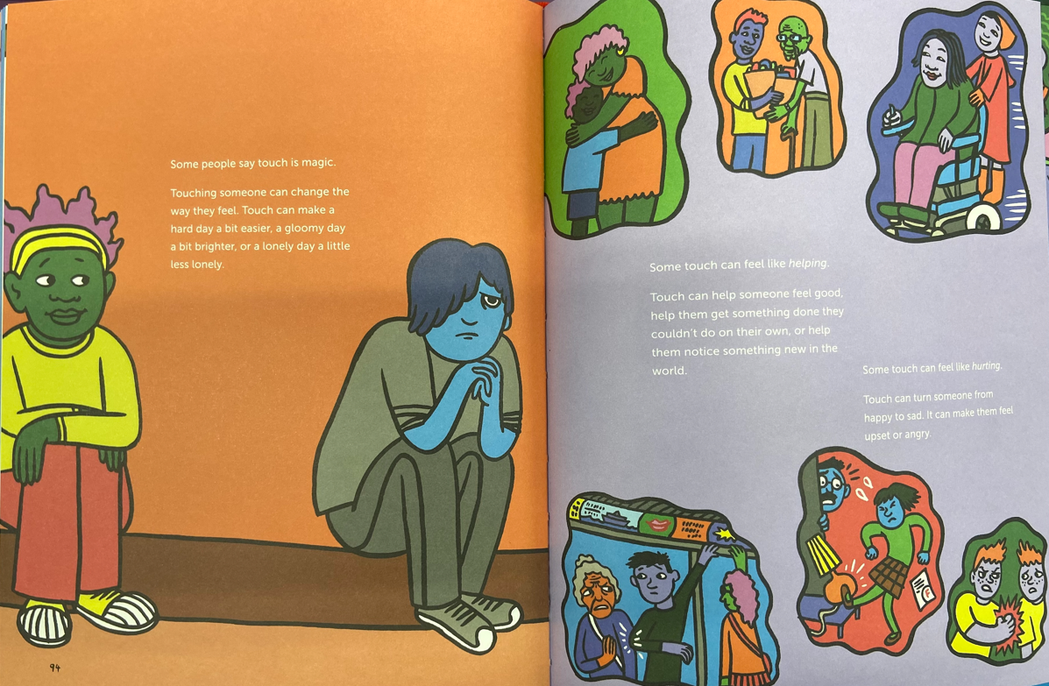


Year 4 Resources
ACCEPT, RESPECT, EMPATHISE

Slide 2
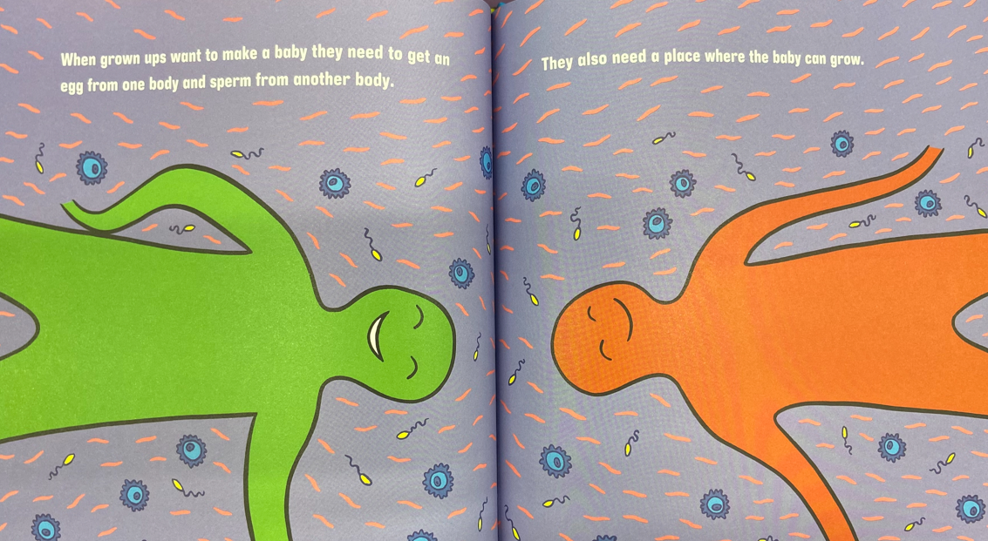
Year 4 Resources
ACCEPT, RESPECT, EMPATHISE

Slide 3

Year 4 Resources
ACCEPT, RESPECT, EMPATHISE

Slide 4
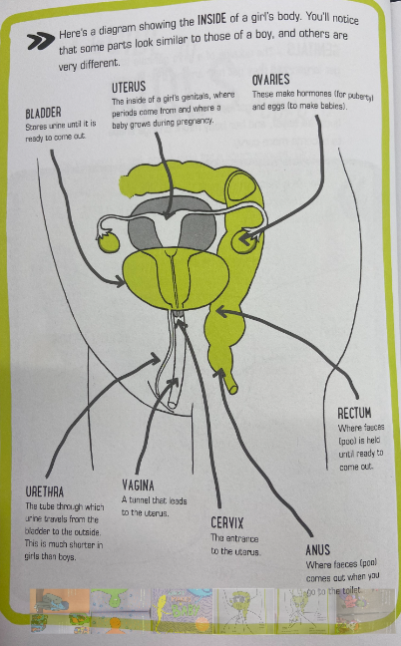
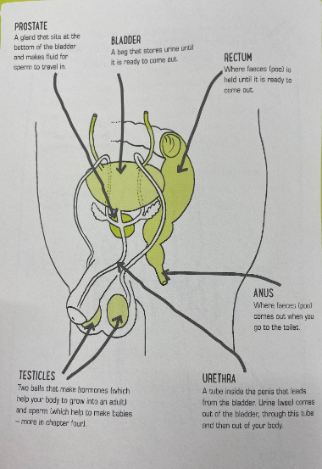
Year 4 Resources
ACCEPT, RESPECT, EMPATHISE

Slide 5
Year 4 Resources
ACCEPT, RESPECT, EMPATHISE

