Slide 1
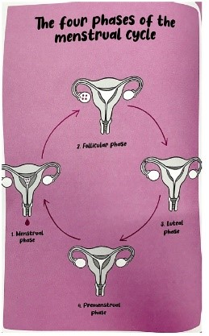
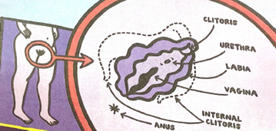


Year 5 Resources
https://www.youtube.com/watch?v=vXrQ_FhZmos
ACCEPT, RESPECT, EMPATHISE

Slide 2
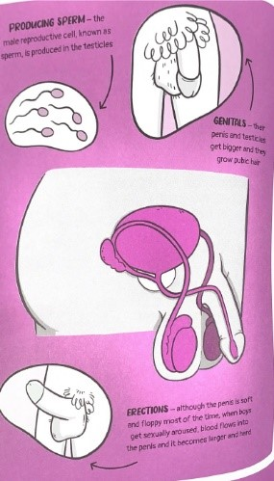
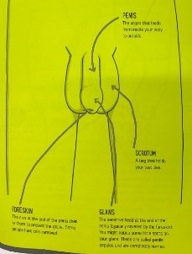
Year 5 Resources
ACCEPT, RESPECT, EMPATHISE

Slide 3
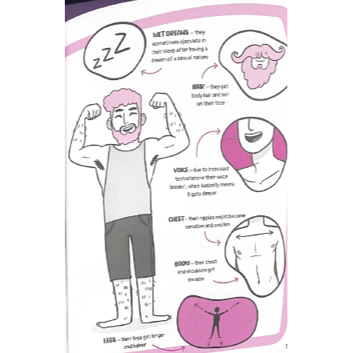
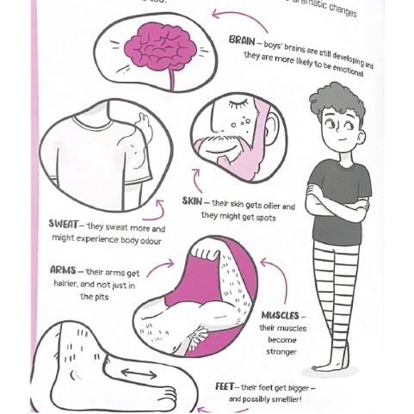
Year 5 Resources
https://www.youtube.com/watch?v=6HygVJA6AgQ
ACCEPT, RESPECT, EMPATHISE

